Slide 1
Analyzing PUB-G Game Play
Presented by Mehr Tandon, Jonah Soberano
With Eliot McGinnis, Valarie Gao, and Geoffrey Gerdau

Slide 2

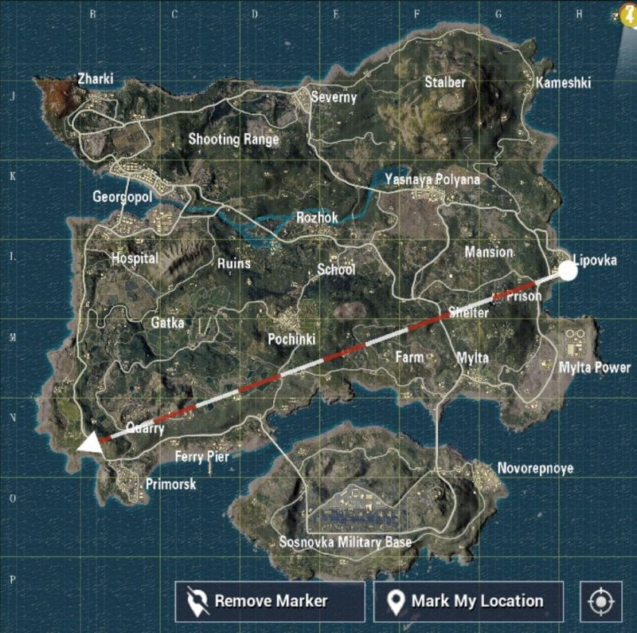
What is PUB-G?
Components of PUB-G
Type: Fighting Game, Battle-Royale Style
Number of Players: Up to 100
Goal: Last Player Standing
Shrinking Circle: Forces Players to Fight
Maps: Sanhok, Erangel, Miramar, Vikendi
Loot: In areas of the map
Goal of Our Analysis
Identify player strategies and trends to improve chances of winning
Assuming luck, aiming skill and instinct are equal

Slide 3
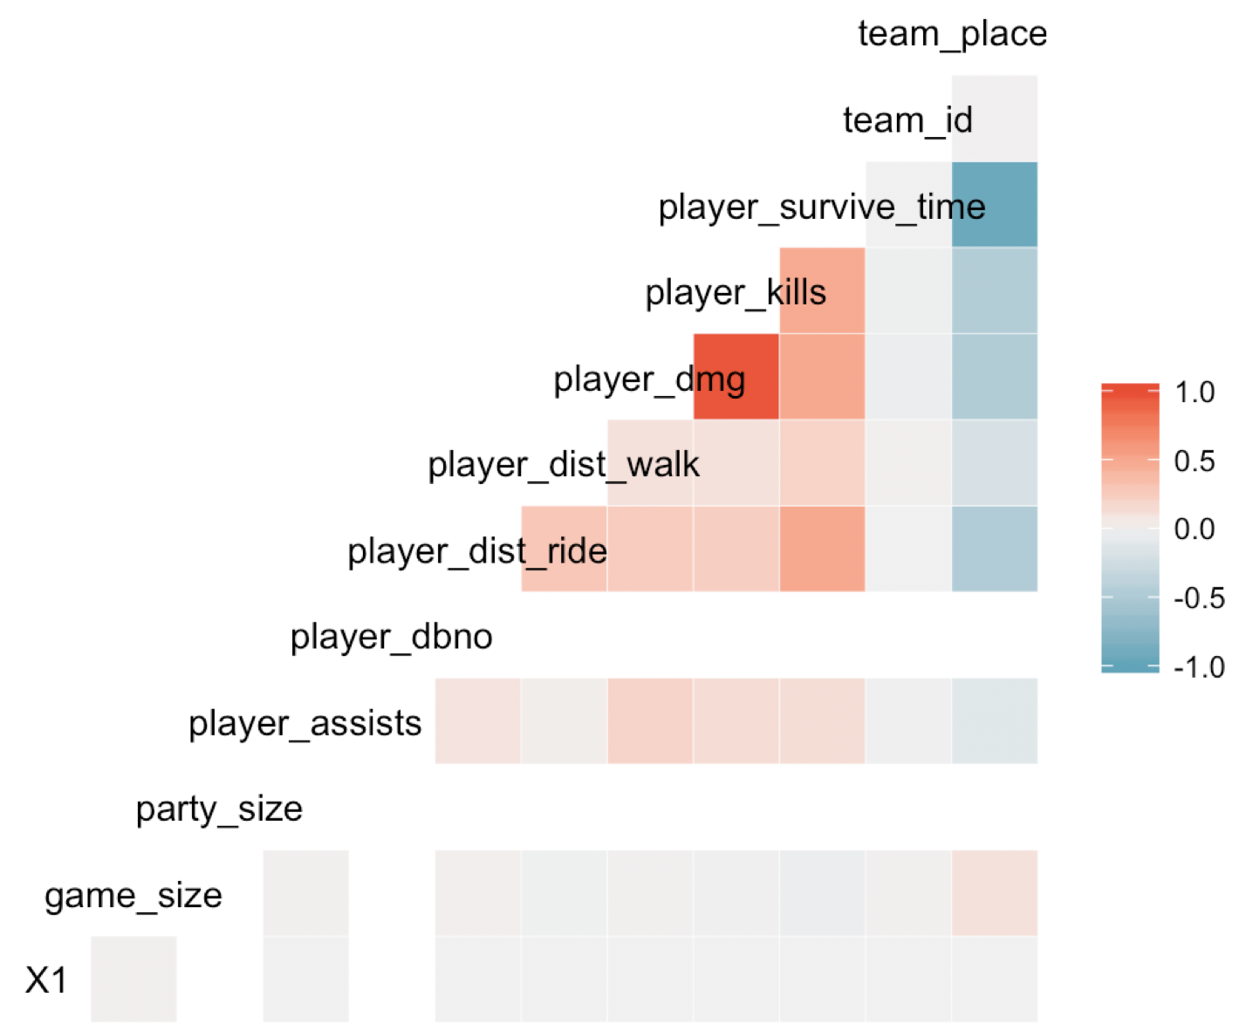
Our Data, Quantitative Variables and their Correlations
Obtained from Kaggle, scraped from ‘pubg.op.gg’ which tracks data from matches played on Steam.
Dataset:
2 Datasets: aggregated match statistics and death event statistics.
Averaging 95 players per game.
Each dataset had 9000 unique games.
Maps: Erangel
Correlation between quantitative variables.
Notes:
Survival time is highly negatively correlated with team placement: longer you survive, lower your placement number
Damage inflicted is highly correlated with the player kills which also intuitively makes sense.

Slide 4
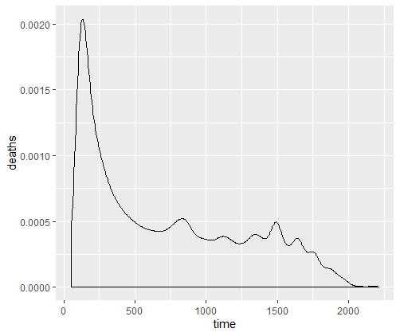
Death vs. Time PDF
Skewed right graph, shows that majority of deaths occur with first 500 seconds of the game.
Spikes occur throughout the game, but overall downward trend.

Slide 5
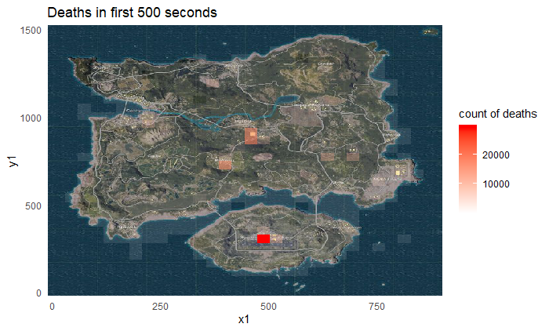
A Closer Look at First 500
Most deaths occur at the military base, Pochinki and the School which are places that players most commonly cluster at.
Notes:
To find this we used the x and y coordinates of the kill locations given on the map and plotted it onto the ERANGEL map

Slide 6
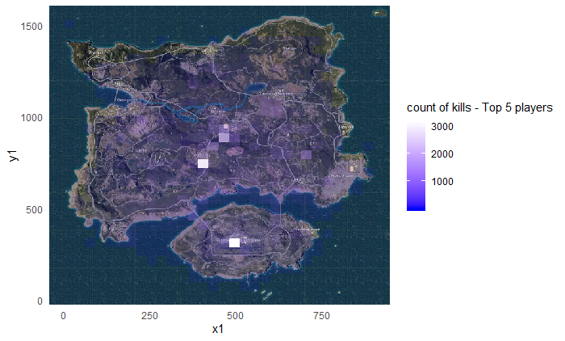
Top 5 Player Kills
Emphasizes that the concentration of kills in these areas is a result of top players collecting kills in them.
We see similar concentrations of kills in the previous identified locations.

Slide 7
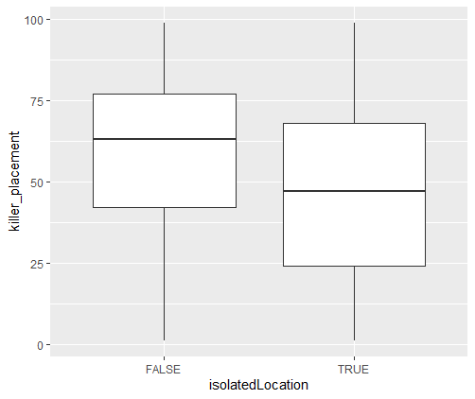
Placement Based on Landing Location
Identified isolatedLocation by binning the areas with high kill concentrations.
Filtered based on first 120 seconds to identify landing locations.
Shows that players who land in isolated locations are more likely to have higher survival time.

Slide 8
Additional Insights
In analyzing top 5 players strategies:
Only one third of the top 5 players landed in hot zones.
Found that other two thirds of top 5 players landed alongside roads, which can be attributed to vehicles spawning on roads.
Within first 500 seconds:
Killing in a hot zone decreases chances of winning, avoid hot zones.
Strongest predictor of success is kill with boat, M249, or MK14.
Important Notes
Assuming you have aiming skill and instinct, you can get the most kills in hot zones but at an increased risk.
However, best strategy to win the game is to land in isolated zones.

